Slide 1
Marketing Mix Decisions

Slide 2
Marketing Mix
With a Marketing Mix, there is four components that one must look at: price, product, place and promotion.
https://www.youtube.com/watch?v=dNDSYW5Zu4E&feature=emb_logo

Slide 3
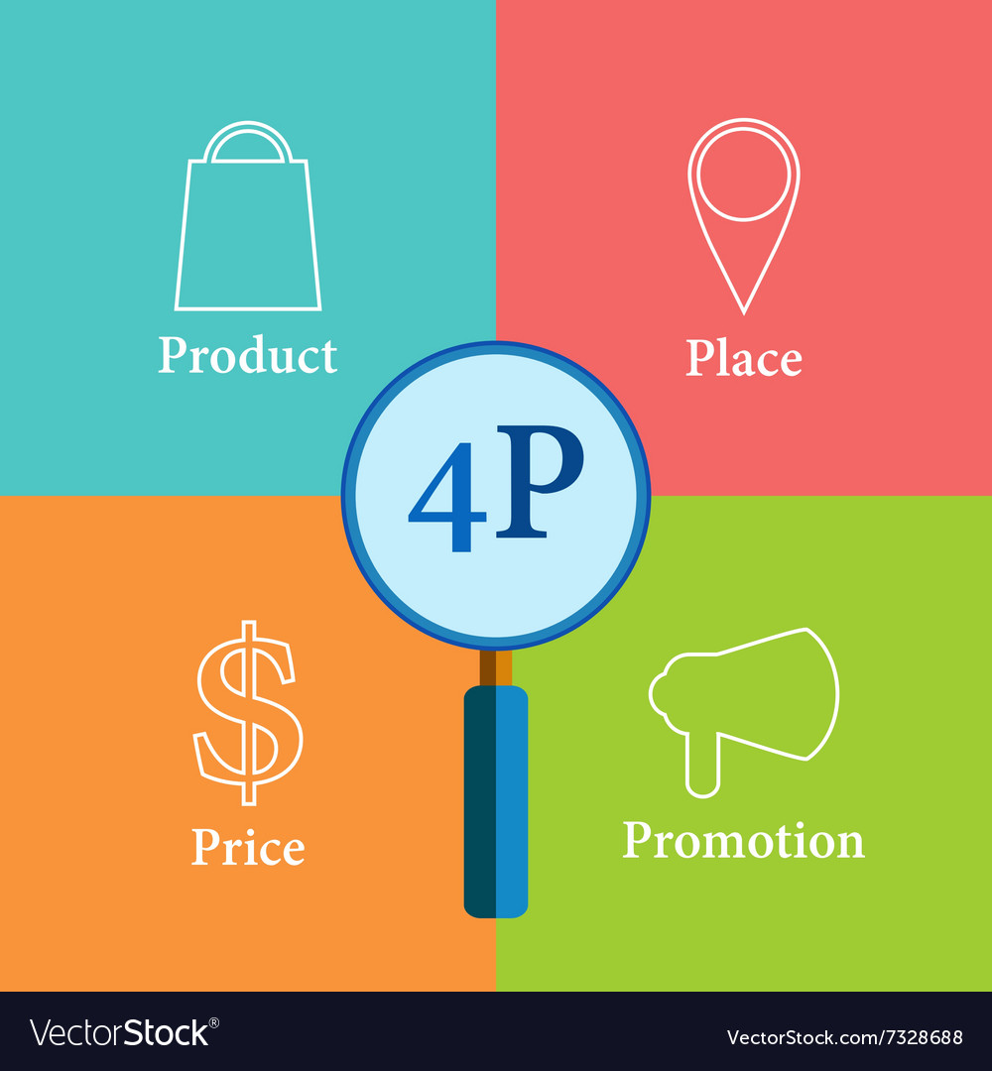
4 P’s of Marketing
Product: Tangible or intangible (this would be a service) that is created to satisfy the needs of a group of customers.
Questions to a business should consider:
What does my customers gain from the product/ experience or service?
How will my customers access my product?
What facilities will I need to be able to offer my product/experience or service?
How is my product different than my competitors?
Place: Refers to the channels a business would use to distribute your product or service. It must be accessible to your potential buyers and may include retail stores, wholesale warehouse or an online store.

Slide 4
4 P’s of Marketing
Price: The amount of money the customers will pay for the product or service and will depend on what type of service they will receive.
Questions to consider:
How much does it cost the business to offer this product or service?
What does the customer think your product/experience is worth?
What are my competitors charging for a similar experience?
Will my seasonal business will affect my pricing?
Promotion: This is the communication part of marketing. How your product or service is being advertised, where it’s selling, how it’s being merchandised. How you promote your product or service is very important since you are trying to persuade the customers to buy your product and service or to create a positive image of what you are offering.

Slide 5
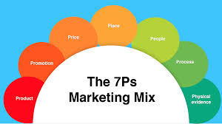
Additions to the Mix
There is also additions added to the original 4 P’s.
Those additions are:
Physical Evidence
Process
People.

Slide 6
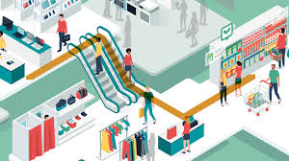
Physical Evidence
This refers to the environment in which a service is delivered.
This could be anything from a retail store, restaurants, hotels, company vehicles and even their websites, blogs and any of their social media accounts.

Slide 7
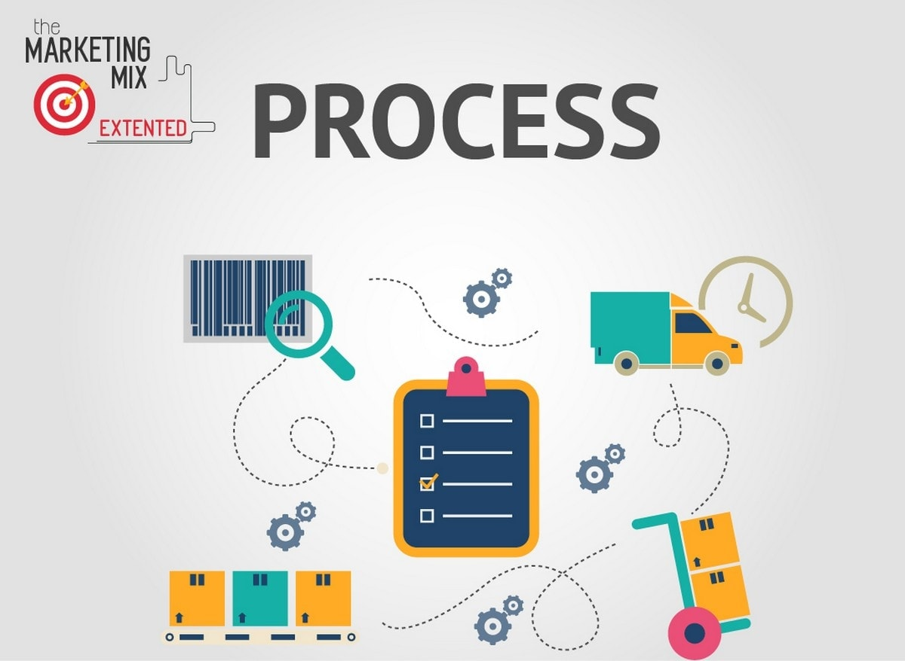
Process
Refers to the process of your business and how it will affect the product or service you deliver. This could be anything such as the planning, manufacturing, customer service or distribution processes.

Slide 8
People
Lastly, people is the final newest component added to the marketing mix. This is might be a little obvious as it refers to the customers that are in your target market, as well as the employees that work for you and your business.
This is especially important in the tourism industry as their experiences are impacted by the customer service that they are receiving. If you have very strong customer service employees who are invested with your organization then they can be a key component to ensuring that you continue to thrive in the industry.
For customer service, you as a business owner should consider:
What training, if any, does my employees need?
How should I monitor their performance?

Slide 9
Promotional Strategies
A business needs to be able create a successful message that will help promote their business to the right target market as well as clearly defining why people should use your product or service.
Many businesses will use multiple mediums, which is also known as integrated media communication (IMC) they must ensure that all the messages that are being broadcasted to the public are all the same.
You can’t have the radio ad stating one thing and a television ad stating something else about the business. If you don’t have a consistent message across all of the promotional channels stating something different, it will only cause confusion with your customers and that is never good.

Slide 10
Advertisements with tourism
Many tourist attractions use stories in their ads that will connect with the emotional side of any potential customers, trying to get them to buy the experience that they are offering.
https://www.youtube.com/watch?v=RXSJU9QoEXo&feature=emb_title

Slide 11
Promotional Strategy

Slide 12
Promotional Strategy

Slide 13
Promotional Strategy

Slide 14
Radio: Advantages and Disadvantages
Advantages
Disadvantages
A voice provides personality for your business.
The message can be creative.
Rates can be adjustable.
Universal medium.
No rewind- if they miss the ad then they can’t go back to listen to it.
Radio is often used as background noise and sometimes the content is ignored.

Slide 15
Newspaper
Advantages
Disadvantages
Reaches large audiences.
Messages can be read again, looked at and cut out for a reminder.
If you need to change the ad you can easily do that.
Ads can be very expensive.
Sometimes the image resolution can be poor.
There is a declining readership, so you might not get the younger audiences.

Slide 16
Television
Advantages
Disadvantages
Can reach audiences on a local, regional and national level
Great visual for the audiences to really get a full effective of what the location is offering
Messages are temporary, you only see them for a short period of time and you can quickly miss it.
Many individuals now only use streaming services so you might not be reaching as many people as you think you will.

Slide 17
Internet
Advantages
Disadvantages
Pay only based on the clicks that your ad receives from the website
Can adjust and make it ideal for your target market
Very easy to track
Prices do continue to rise as there is more of a demand when it comes to the competition
It requires a lot of constant monitoring.

Slide 18
Social Media
Advantages
Disadvantages
Builds customer relationships
Potential for viral marketing
Traffic can be targeted
If you are using to promote your business you are appealing to a wide variety of individuals, especially in the younger age group.
If you are using it to broadcast your ad, many individuals scroll right past, and don’t pay attention.
Hard to build up product awareness
Some audiences are too diverse.

Slide 19
Personal Selling
Advantages
Disadvantages
You can give more information on what you are offering
Allows you have to deeper impact on your protentional customers.
Very limited with how many people you are reach
It can be very expensive.

Slide 20
Direct Mail
Advantages
Disadvantages
Targeted to those who buy your product
Can be personalized and is easily measured.
Considered to be a nuisance by many individuals and can often be thrown out or deleted if it is coming from an email.

Slide 21
Assignment
Create an ad or promotion for your business.
You can make a brochure ad, newspaper ad, flyer or any other type of advertisement you can think of.
You can do a 30 second video or audio recording as an option too as if we were watching on television or listening on the radio.
Must include:
Name and your logo
Well crafted message that explains the experience
Contract information as well as location
Price
Hours of operation.

