Slide 1
Government of Canada
Federalism

Slide 2
Federalism
Refers to a mixed mode of government. Where the decisions that are made for different government activities are done so by combining regional and central governments
There are a variety of forms of federalism, depending on the degree of centralized authority of the national government.

Slide 3
Different Forms
Unitary Government: when a sovereign state is governed by one level of power.
Centralized Federalism: when there are two levels of power, but it’s controlled by the dominant, central government.
Confederation: one level of power, so that all states are equal

Slide 4
Canadian Federalism
When the Constitution Act was signed, it gave certain powers and jurisdictions to the Federal and Provincial levels of government. Allowing each of the provinces the power to pass legislation, again giving certain powers at the local or municipal levels of government.
However there has been a lot of debate, discussion and tension between the Federal government and provinces since the very beginning. Some examples of this would be…

Slide 5
Examples
The threat of the Quebec separatism, they nearly won majority to separate in 1995.
The Western Alienation and disputes over resources. Many Albertans were in dispute with the Federal government due to the oil prices, they were almost half of Albertans in 1981, were in favour of separating.
Controversies over minority language and education rights (bilingualism at the Federal and provincial level)

Slide 6
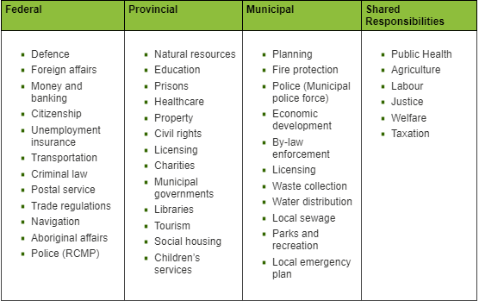
Division of Power

Slide 7
Federalism in Canada
Check out this webpage, it will give a more detailed information on Federalism in Canada and there are a couple of videos that you can view as well.
https://www.thecanadianencyclopedia.ca/en/article/federalism

Slide 8
Assignment #1
Do you think the following events have helped move Canadian Federalism towards or away from a strong centralized government. These are some opinion-based questions.
  Alberta Oil Discovery (1950s)
  Quebec’s Quiet Revolution (1960’s)
  Great Depression (1930)
  World War 1 and Conscription (1914-1918)

Slide 9
Assignment #2
Quebec Separatism
  There are many issues in Canadian Federalism, but the one issue that has dominated our focus almost continually in the last three decades has been that of Quebec Separatism. Research and answer the following:
  a) Why do some Quebecois want their own separate state?
  b) Are the grievances of Quebec substantial and justified?
  c) What success has the sovereignty movement had in Quebec?
  d) How has the federal government responded since 1980?

