Slide 1
WELLNESS 110
WELLNESS THROUGH PHYSICAL EDUCATION
THE WEIRD WORLD OF WACKY SPORTS

Slide 2
Task:
Within our society exists a number of strange, wacky and possibly dangerous sports. Some date back long ago in history (Cheese Rolling) whereas others are fairly new (Zorbing).
This project tasks you with researching 5 Weird Sports. Each slide is set up for you to add the necessary information:
Description
Brief History
World Popularity
Picture or Video
Reflection Questions

Slide 3
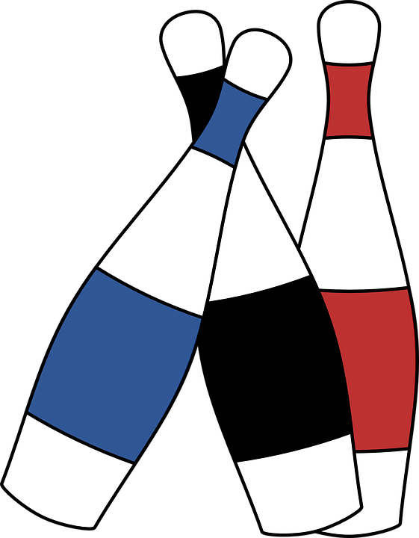
Sport #1: Combat Juggling
EXAMPLE
Description: Combat Juggling is a team sport where each competitor juggles three clubs while attempting to eliminate their opponents by interfering with their ability to juggle. This is traditionally accomplished by throwing one of the three clubs high into the air and using one of the other two clubs to knock a club out of the air or hand of their opponent. The competitor on the attack must resume their juggling pattern to remain in the competition.
History: A historical record of the sport is challenging to find. However, one source suggests that the sport began in the early 1980s in California.
World Popularity: United States and Europe
Work Cited: https://www.thewjf.com/combat-juggling/
https://juggle.fandom.com/wiki/Combat#cite_note-0

Slide 4
Sport: Combat Juggling
EXAMPLE
Pictures or Video:

Slide 5
Sport #1:
Description:
History:
World Popularity:
Work Cited:

Slide 6
Sport #1:
Pictures or Video:

Slide 7
Sport #2:
Description:
History:
World Popularity:
Work Cited:

Slide 8
Sport #2:
Pictures or Video:

Slide 9
Sport #3:
Description:
History:
World Popularity:
Work Cited:

Slide 10
Sport #3:
Pictures or Video:

Slide 11
Sport #4:
Description:
History:
World Popularity:
Work Cited:

Slide 12
Sport #4:
Pictures or Video:

Slide 13
Sport #5:
Description:
History:
World Popularity:
Work Cited:

Slide 14
Sport #5:
Pictures or Video:

Slide 15
Reflection:
Of all the sports you researched…
Which sport would attempt to try?
Why would you attempt it?
Do you think you would be successful?

