Slide 1
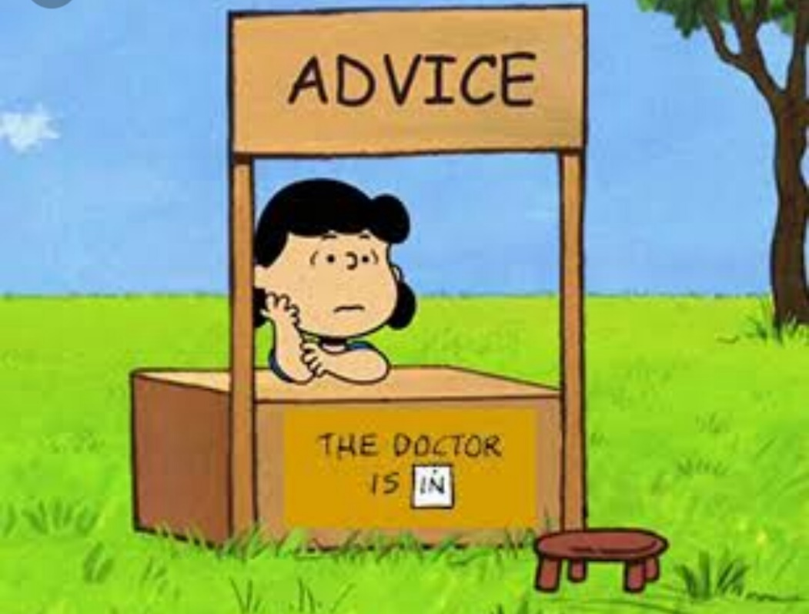
Journal # 9
Write about the best piece of advice you ever received. Who gave you the advice? Did you follow it? What was the outcome? Provide plenty of details.

